Slide 1



SMART INDIA HACKATHON 2025
• Problem Statement ID –SIH25121
• Problem Statement Title-
Student Innovation: Swadeshi for
Atmanirbhar Bharat
• Theme- Transportation & Logistics • PS Category- Hardware • Team ID- SIHCS/20252646
• Team Name- Smart-ResQ Team
1

Slide 2


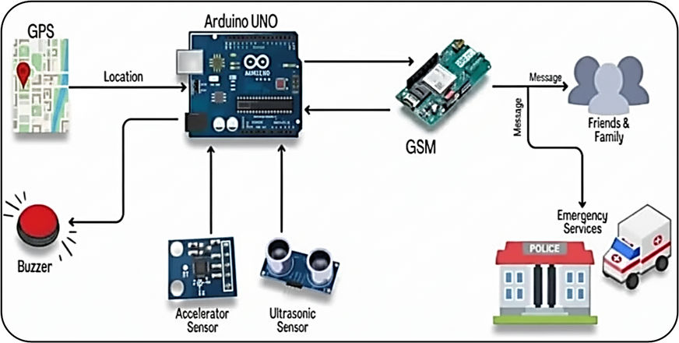

Smart ResQ System
Res-Q
Mates
Proposed Solution
  IoT hardware for emergency rescue in accidents, vehicle breakdowns, medical emergencies, and thefts
  Automated detection using sensors, GPS, and GSM modules; triggers real-time alerts
  Instant transmission of location to hospitals, police stations, towing, and crime response teams—even without smartphones or internet access
  Integrated theft detection capabilities , sends urgent crime alerts to nearest police units
  Reliable communication to reduce rescue and police response delays, improving overall safety
  Low-cost, portable, Arduino-based hardware—easy to deploy
  Maintains connectivity even during weak networks via dual SIM, offline storage, and auto-alerts
  Saves lives and property by enabling rapid, accurate rescue and police intervention
Project Simulation
2
2
@SIH Idea submission

Slide 3
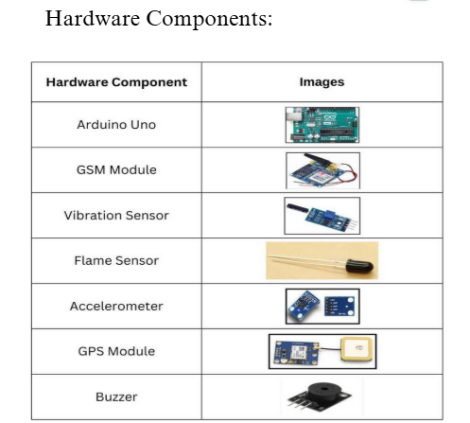
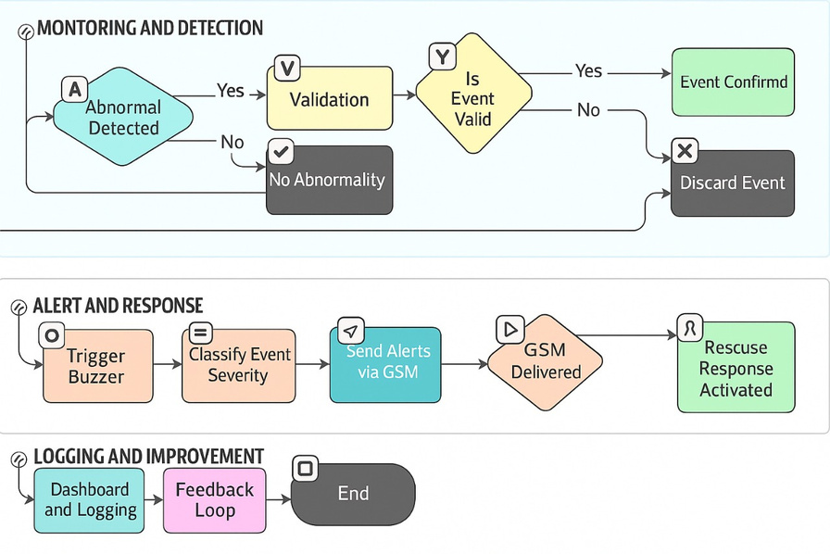
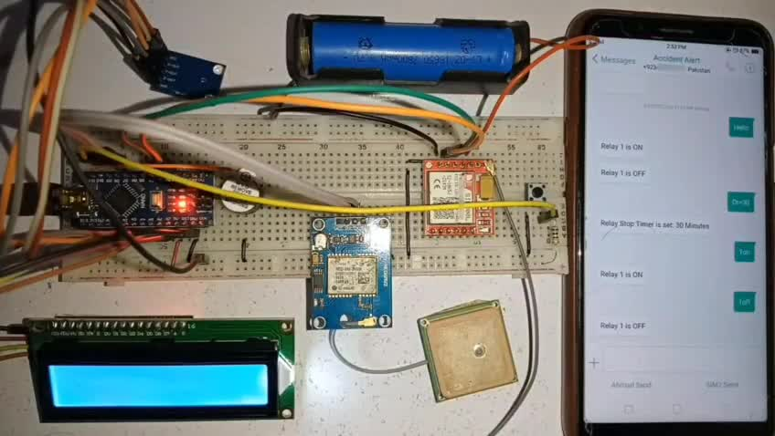
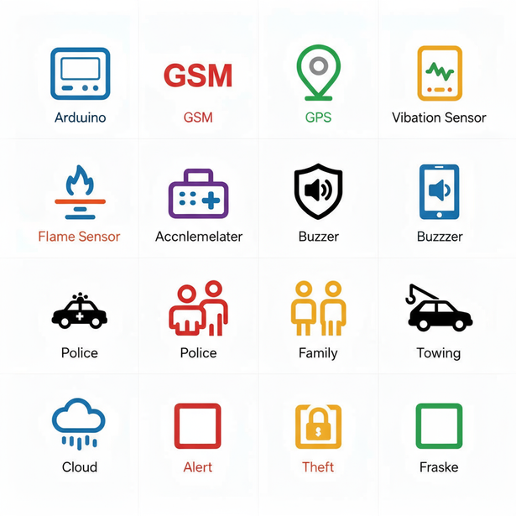


Res-Q
Mates
TECHNICAL APPROACH
Technology Stack
  Controller: Arduino Uno
  Connectivity: GSM, dual SIM for reliable network
  Location: GPS module for precision tracking
  Sensors: Vibration, ultrasonic, flame, accelerometer for comprehensive threat detection
  Alert System: Buzzer, SMS/GSM, encrypted data transmission
  Cloud Option: Can integrate with IoT and web dashboards for reports and analytics
Arduino.
Vibration Sensor
Accelerometer
Ambulance
@SIH Idea submission

Slide 4
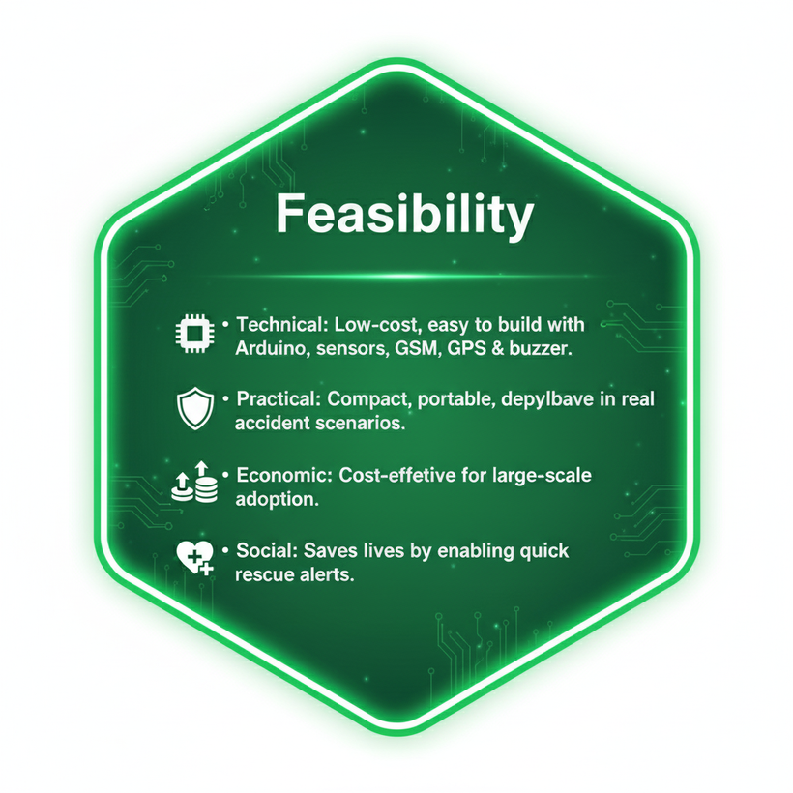


FEASIBILITY AND VIABILITY
Res-Q
Mates
4
4
@SIH Idea submission

Slide 5
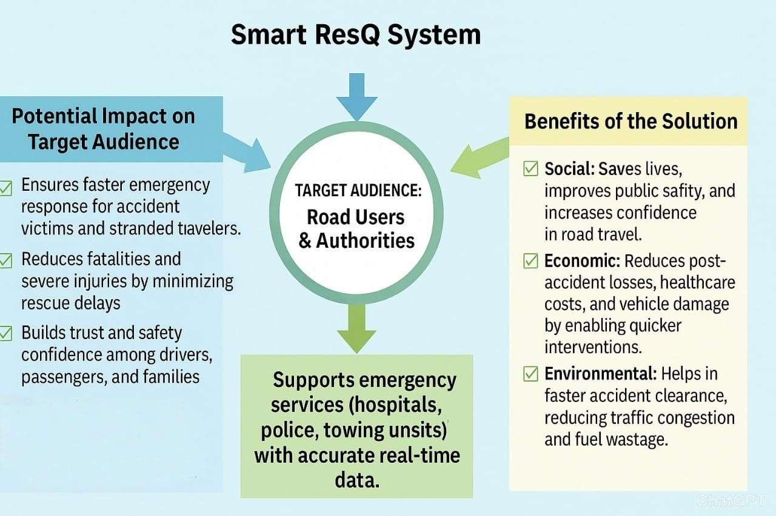
Res-Q
Mates
IMPACT AND BENEFITS
5
5
@SIH Idea submission

Slide 6
Res-Q
Mates
RESEARCH AND REFERENCES
Comparision With Exiseting System
REFERENCES
Feature / System | Proposed System (Smart-ResQ) | IoT Accident Detection | GSM+GPS System | ML-based Crash Detection | Cloud-enabled Alert
Real-time Accident Detection | ✅ | ✅ | ✅ | ✅ | ✅
GPS Location Tracking | ✅ | ✅ | ✅ | ✅ | ✅
GSM/SMS Alert to Emergency Contacts | ✅ | ✅ | ✅ | ❌ | ✅
Automatic Timer (to verify false alarm) | ✅ | ❌ | ❌ | ✅ | ❌
Dual Communication (GSM + GPRS/Internet) | ✅ | ❌ | ❌ | ❌ | ✅
Cloud Data Logging & Analytics | ✅ | ❌ | ❌ | ❌ | ✅
Dashboard Visualization (React-based) | ✅ | ❌ | ❌ | ❌ | ✅
AI/ML-based Accuracy Enhancement | ✅ | ❌ | ❌ | ✅ | ✅
Cost Effective & Scalable | ✅ | ❌ | ✅ | ❌ | ❌
  IEEE 10810843 – Emergency Assistance Accident Detection and Alert System
  https://ieeexplore.ieee.org/document/10810843
  IEEE 11018899 – Transnomous
  https://ieeexplore.ieee.org/document/11018899
  IEEE 10290672 – Automated Vehicle Accident Alert System (IoT)
  https://ieeexplore.ieee.org/document/10290672
  IEEE 10617133 – Raspberry Pi Enabled Collision Alert System.
  https://ieeexplore.ieee.org/document/10617133
Where Our Solutions Would have worked
  WHO reports that 30% of road accident deaths are due to delayed emergency response.
  Eleven people died in a pickup van-truck collision near Dausa, Rajasthan, with emergency services responding quickly.
  Nearly 26,770 people died on Indian National Highways due to accidents in the first half of 2025 alone
6
6
@SIH Idea submission

